Slide 1

Chapter 9 (Part 1): Graphs
Graph Terminology (9.2) (cont.)
Representing Graphs &
Graph Isomorphism (9.3)
Connectivity (9.4)
Notes:
CSE 504 Discrete Structures & Foundations of Computer Science
Dr. Djamel Bouchaffra
Ch. 8 (Part 2: Sections 8.2 (cont.), 8.3 & 8.4 ): Graphs

Slide 2
Graph Terminology (9.2) (cont.)
Some special simple graphs
  Complete graph
  They are denoted by K_{n}, they contain exactly one edge between each pair of distinct vertices
Dr. Djamel Bouchaffra
CSE 504 Discrete Structures & Foundations of Computer Science, Ch. 8 (part 2): Graphs

Slide 3
Graph Terminology (9.2) (cont.)
K₁
K₂
K₃
K₄
The graphs K_{n} for
1 ≤ n ≤ 6
K₅
K₆
Dr. Djamel Bouchaffra
CSE 504 Discrete Structures & Foundations of Computer Science, Ch. 8 (part 2): Graphs

Slide 4
Graph Terminology (9.2) (cont.)
  Cycles
  They are denoted by C_{n}(n ≥ 3): they consist of n vertices v₁, v₂, …, v_{n} and edges {v₁, v₂}, {v₂, v₃}, …, {v_{n}, v_{n-1}} and {v_{n}, v₁}
Dr. Djamel Bouchaffra
CSE 504 Discrete Structures & Foundations of Computer Science, Ch. 8 (part 2): Graphs

Slide 5
Graph Terminology (9.2) (cont.)
C₃
C₄
The cycles
C₃, C₄, C₅ & C₆
C₅
C₆
Dr. Djamel Bouchaffra
CSE 504 Discrete Structures & Foundations of Computer Science, Ch. 8 (part 2): Graphs

Slide 6
Graph Terminology (9.2) (cont.)
  Wheels
  They are denoted by W_{n}; they are obtained by adding a vertex to the graphs C_{n} and connect this vertex to all vertices
  Definition: We obtain the wheel W_{n} when we add an additional vertex to the cycle C_{n}, for n ≥ 3, and connect this new vertex to each of the n vertices in C_{n} by adding new edges.
Dr. Djamel Bouchaffra
CSE 504 Discrete Structures & Foundations of Computer Science, Ch. 8 (part 2): Graphs

Slide 7
Graph Terminology (9.2) (cont.)
W₃
W₄
The Wheels W₃,
W₄, W₅ & W₆
W₅
W₆
Dr. Djamel Bouchaffra
CSE 504 Discrete Structures & Foundations of Computer Science, Ch. 8 (part 2): Graphs

Slide 8
Graph Terminology (9.2) (cont.)
  n-cubes
  They are denoted by Q_{n}, they are graphs that have vertices representing the 2^{n} bit strings of length n.
  Two vertices are adjacent if and only if the bits strings that they represent differ in exactly one bit position
Dr. Djamel Bouchaffra
CSE 504 Discrete Structures & Foundations of Computer Science, Ch. 8 (part 2): Graphs

Slide 9
Graph Terminology (9.2) (cont.)
110
111
10
11
101
100
010
011
0
1
00
01
000
001
Q₁
Q₂
Q₃
The n-cube Q_{n} for n = 1, 2, and 3.
Dr. Djamel Bouchaffra
CSE 504 Discrete Structures & Foundations of Computer Science, Ch. 8 (part 2): Graphs

Slide 10
Graph Terminology (9.2) (cont.)
Bipartite graph
  Definition 5:
  A simple graph is called bipartite if its vertex set V can be partitioned into 2 disjoint sets V₁ and V₂ such that every edge in the graph connects a vertex in V₁ and a vertex in V₂ (so that no edge in G connects either 2 vertices in V₁ or 2 vertices in V₂).
Dr. Djamel Bouchaffra
CSE 504 Discrete Structures & Foundations of Computer Science, Ch. 8 (part 2): Graphs

Slide 11
Graph Terminology (9.2) (cont.)
  Example: C₆ is bipartite, since its vertex set can be partitioned into the 2 sets V₁ = {v₁, v₃, v₅} and V₂ = {v₂, v₄, v₆}, and every edge of C₆ connects a vertex in V₁ and a vertex in V₂.
  Example: K₃ is not bipartite. Why?
V₁
V₂
v₁
v₂
v₃
v₄
v₅
v₆
Dr. Djamel Bouchaffra
CSE 504 Discrete Structures & Foundations of Computer Science, Ch. 8 (part 2): Graphs

Slide 12
Graph Terminology (9.2) (cont.)
  Characterization of bipartite graph
    A graph is bipartite if and only if it is possible to color the vertices of the graph with at most 2 colors so that no 2 adjacent vertices have the same color
    Example: Complete bipartite graphs: they are denoted by K_{m,n}. Their vertices set is partitioned into 2 subsets of m and n vertices, respectively. There is an edge between 2 vertices if and only if one vertex is in the first subset and the other vertex is in the second subset.
Dr. Djamel Bouchaffra
CSE 504 Discrete Structures & Foundations of Computer Science, Ch. 8 (part 2): Graphs

Slide 13
Graph Terminology (9.2) (cont.)
K_{2,3}
K_{3,3}
K_{3,5}
K_{2,6}
Some complete bipartite graphs
Dr. Djamel Bouchaffra
CSE 504 Discrete Structures & Foundations of Computer Science, Ch. 8 (part 2): Graphs

Slide 14
Graph Terminology (9.2) (cont.)
Some applications of special types of graphs
  Local area network
  Goal: connecting computers as well as peripheral devices in a building using a local area network topology
  Some of these networks are based on a star topology, where all devices are connected to a central control device
  The star topology is equivalent to a K_{1,n} complete bipartite graph
Dr. Djamel Bouchaffra
CSE 504 Discrete Structures & Foundations of Computer Science, Ch. 8 (part 2): Graphs

Slide 15
Graph Terminology (9.2) (cont.)
  Other local area networks use a ring topology ⇔ C_{n} graphs
  Finally, the hybrid topology which is equivalent to a W_{n} graph is also used
Dr. Djamel Bouchaffra
CSE 504 Discrete Structures & Foundations of Computer Science, Ch. 8 (part 2): Graphs

Slide 16
Graph Terminology (9.2) (cont.)
(a)
(b)
(c)
Star, ring, and hybrid topologies for local area networks
Dr. Djamel Bouchaffra
CSE 504 Discrete Structures & Foundations of Computer Science, Ch. 8 (part 2): Graphs

Slide 17
Graph Terminology (9.2) (cont.)
  Interconnection networks for parallel processing
    Linear arrays for processor connection
    Mesh network (Markovian neighborhood)
    Hypercube interconnection (generalization of n-cubes)
Dr. Djamel Bouchaffra
CSE 504 Discrete Structures & Foundations of Computer Science, Ch. 8 (part 2): Graphs

Slide 18
Representing Graphs & Graph Isomorphism
Introduction
  Goal: Consists of choosing the most convenient representation of a graph
  We need to determine whether 2 graphs are isomorphic, this problem is important in graph theory
Dr. Djamel Bouchaffra
CSE 504 Discrete Structures & Foundations of Computer Science, Ch. 8 (part 2): Graphs

Slide 19
Representing Graphs & Graph Isomorphism (9.3) (cont.)
Representing Graph
  List all the edges of the graph (no multiple edges)
  Use adjacency list, which specifies the vertices that are adjacent to each vertex of the graph
Dr. Djamel Bouchaffra
CSE 504 Discrete Structures & Foundations of Computer Science, Ch. 8 (part 2): Graphs

Slide 20
Representing Graphs & Graph Isomorphism (9.3) (cont.)
  Example: Use adjacency lists to describe this simple graph.
b
a
c
e
d
Vertex | Adjacent vertices
a b c d e | b, c, e a a, d, e c, e a, c, d
Solution:
Dr. Djamel Bouchaffra
CSE 504 Discrete Structures & Foundations of Computer Science, Ch. 8 (part 2): Graphs

Slide 21
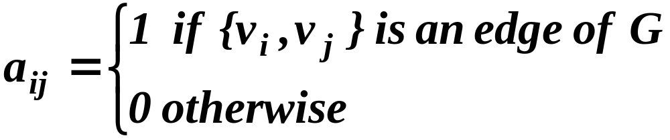
Representing Graphs & Graph Isomorphism (9.3) (cont.)
Adjacency matrices
  To simplify computation, graphs can be represented using matrices
    Adjacency matrix
    Incident matrix
  The adjacency matrix is defined as A = [a_{ij}] such that
Dr. Djamel Bouchaffra
CSE 504 Discrete Structures & Foundations of Computer Science, Ch. 8 (part 2): Graphs

Slide 22
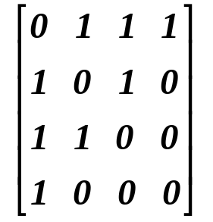
Representing Graphs & Graph Isomorphism (9.3) (cont.)
  Example: Use a adjacency matrix to represent this graph:
a
b
c
d
Solution: We order the vertices a, b, c, d.
The matrix representing this graph is
Dr. Djamel Bouchaffra
CSE 504 Discrete Structures & Foundations of Computer Science, Ch. 8 (part 2): Graphs

Slide 23
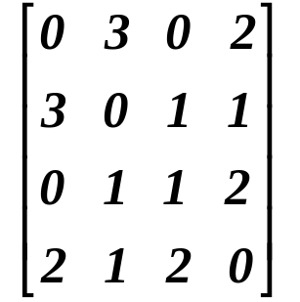
Representing Graphs & Graph Isomorphism (9.3) (cont.)
  In case of pseudographs , the adjacency matrix is not a binary matrix but is formed of elements that represent the number of edges between 2 vertices
  Example: Use an adjacency matrix to represent this pseudograph:
a
b
c
d
Solution: The adjacency matrix using
The ordering of vertices a, b, c, d is:
Dr. Djamel Bouchaffra
CSE 504 Discrete Structures & Foundations of Computer Science, Ch. 8 (part 2): Graphs

Slide 24
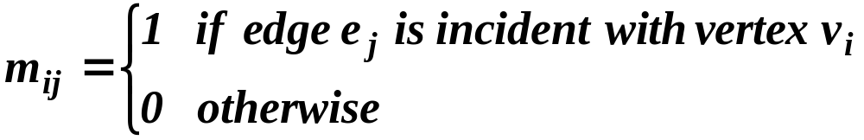
Representing Graphs & Graph Isomorphism (9.3) (cont.)
Incidence matrices
  Let G = (V,E) be an undirected graph.
  Incidence matrices are defined by the matrix
  M = [m_{ij}] such that
Dr. Djamel Bouchaffra
CSE 504 Discrete Structures & Foundations of Computer Science, Ch. 8 (part 2): Graphs

Slide 25
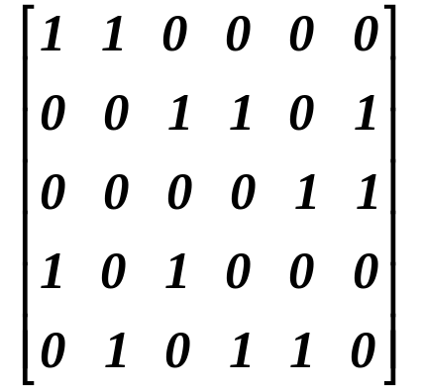
Representing Graphs & Graph Isomorphism (9.3) (cont.)
  Example: Using an incidence matrix, represent the following undirected graph:
v₁
v₂
e₆
v₃
e₂
e₄
e₁
e₅
e₃
v₄
v₅
e₁ e₂ e₃ e₄ e₅ e₆
v₁
v₂
v₃
v₄
v₅
Solution:
Dr. Djamel Bouchaffra
CSE 504 Discrete Structures & Foundations of Computer Science, Ch. 8 (part 2): Graphs

Slide 26
Representing Graphs & Graph Isomorphism (9.3) (cont.)
Isomorphism of graphs
  Goal: is it possible to draw 2 graphs in the same way?
  In chemistry, different graph compounds can have the same molecular formula but can differ in structure
  The graphs of these compounds cannot be drawn in the same way
  Graphs having the same structure share common properties
  Degree sequences of G₁ and G₂ are same
Dr. Djamel Bouchaffra
CSE 504 Discrete Structures & Foundations of Computer Science, Ch. 8 (part 2): Graphs

Slide 27
Representing Graphs & Graph Isomorphism (9.3) (cont.)
  Definition 1:
  The simple graphs G₁ = (V₁,E₁) and G₂ = (V₂,E₂) are isomorphic if there is a one-to-one and onto function f from V₁ to V₂ with the property that a and b are adjacent in G₁ if and only if f(a) and f(b) are adjacent in G₂, for all a and b in V₁. Such a function f is called an isomorphism.
Dr. Djamel Bouchaffra
CSE 504 Discrete Structures & Foundations of Computer Science, Ch. 8 (part 2): Graphs

Slide 28
Representing Graphs & Graph Isomorphism (9.3) (cont.)
  Example: Show that the graphs G = (V,E) and
  H = (W,F) are isomorphic
u₁
u₂
v₁
v₂
u₃
u₄
v₃
v₄
G
H
  Solution: The function f with f(u₁) = v₁, f(u₂) = v₄, f(u₃) = v₃, f(u₄) = v₂ is a one-to-one correspondence between V and W. To see that this correspondence preserves adjacency, note that adjacent vertices in G are u₁ and u₂, u₁ and u₃, u₂ and u₄, and u₃ and u₄, and each of the pairs f(u₁) = v₁ and f(u₂) = v₄, f(u₁) = v₁ and f(u₃) = v₃, f(u₂) = v₄ and
  f(u₃) = v₃, and f(u₁) = v₁ and f(u₄) = v₂ are adjacent in H.
Dr. Djamel Bouchaffra
CSE 504 Discrete Structures & Foundations of Computer Science, Ch. 8 (part 2): Graphs

Slide 29
Connectivity (9.4)
Goal: determination of paths within graphs
Many problems can be modeled with paths formed by traveling along the edges of graphs
Some examples of problems are:
  Study the link between remote computers
  Efficient planning of routes for mail delivery
  Garbage pickup
  Diagnostic in computer networks
Dr. Djamel Bouchaffra
CSE 504 Discrete Structures & Foundations of Computer Science, Ch. 8 (part 2): Graphs

Slide 30
Connectivity (9.4) (cont.)
Path
  Definition 1:
  Let n be a nonnegative integer and G an undirected graph. A path of length n from u to v in G is a sequence of n edges e₁, e₂, …, e_{n} of G such that f(e₁) = {x₀, x₁},
  f(e₂) = {x₁, x₂}, …, f(e_{n}) = {x_{n-1}, x_{n}}, where x₀ = u and x_{n} = v. When the graph is simple, we denote this path by its vertex sequence x₀, x₁, …, x_{n} (since listing these vertices uniquely determines the path). The path is a circuit if it begins and ends at the same vertex, that is, if u = v, and has length greater than zero. The path or circuit is said to pass through the vertices x₁, x₂, …, x_{n-1} or traverse the edges e₁, e₂, …, e_{n}. A path or circuit is simple if it does not contain the same edge more than once.
Dr. Djamel Bouchaffra
CSE 504 Discrete Structures & Foundations of Computer Science, Ch. 8 (part 2): Graphs

Slide 31
Connectivity (9.4) (cont.)
a
b
c
  Example:
  In this simple graph a, d, c, f, e is a simple path of length 4, since {a,d}, {d,c}, {c,f}, and {f,e} are all edges.
  However, d, e, c, a is not a path, since {e,c} is not an edge.
  Note that b, c, f, e, b is a circuit of length 4 since {b,c}, {c,f}, {f,e}, and {e,b} are edges, and this path begins and ends at b.
  The path a, b, e,d,a,b, which is of length 5, is not simple since it contains the edge {a,b} twice.
d
e
f
Dr. Djamel Bouchaffra
CSE 504 Discrete Structures & Foundations of Computer Science, Ch. 8 (part 2): Graphs

Slide 32
Connectivity (9.4) (cont.)
  Definition 2:
  Let n be a nonnegative integer and G a directed multigraph. A path of length n from u to v in G is a sequence of edges e₁, e₂, …, e_{n} of G such that f(e₁) = (x₀, x₁), f(e₂) = (x₁, x₂), …, f(e_{n}) = (x_{n-1}, x_{n}), where x₀ = u and x_{n} = v. When there are no multiple edges in the directed graph, this path is denoted by its vertex sequence x₀, x₁, …, x_{n}. A path of length greater than zero that begins and ends at the same vertex is called a circuit or cycle. A path or circuit is called simple it it does not contain the same edge more than once.
Dr. Djamel Bouchaffra
CSE 504 Discrete Structures & Foundations of Computer Science, Ch. 8 (part 2): Graphs

Slide 33
Connectivity (9.4) (cont.)
Connectedness in undirected graphs
  Question asked:
  When does a computer network have the property that every pair of computers can share information, if message can be sent through one or more intermediate computers?
  This question is equivalent to:
  When is there always a path between 2 vertices in the graph?
Dr. Djamel Bouchaffra
CSE 504 Discrete Structures & Foundations of Computer Science, Ch. 8 (part 2): Graphs

Slide 34
Connectivity (9.4) (cont.)
  Definition 3:
  An undirected graph is called connected if there is a path between every pair of distinct vertices of the graph
  Theorem 1:
  There is a simple path between every pair of distinct vertices of a connected undirected graph
  Proof: Exercise!
Dr. Djamel Bouchaffra
CSE 504 Discrete Structures & Foundations of Computer Science, Ch. 8 (part 2): Graphs

Slide 35
Connectivity (9.4) (cont.)
  A graph that is not connected is the union of two or more connected subgraphs, each pair of which has no vertex in common.
  These disjoint connected subgraphs are called the connected components of the graph
Dr. Djamel Bouchaffra
CSE 504 Discrete Structures & Foundations of Computer Science, Ch. 8 (part 2): Graphs

Slide 36
Connectivity (9.4) (cont.)
Connected in directed graphs
  Definition 4:
  A directed graph is strongly connected if there is a path from a to b and from b to a whenever a and b are vertices in the graph
  Definition 5:
  A directed graph is weakly connected if there is a path between every 2 vertices in the underlying undirected graph
Dr. Djamel Bouchaffra
CSE 504 Discrete Structures & Foundations of Computer Science, Ch. 8 (part 2): Graphs

Slide 37
Connectivity (9.4) (cont.)
  A directed graph is weakly connected ⇔ there is always a path between 2 vertices when the directions of the edges are ignored
  Strongly connected ⇒ weakly connected directed graph
Dr. Djamel Bouchaffra
CSE 504 Discrete Structures & Foundations of Computer Science, Ch. 8 (part 2): Graphs

Slide 38
Connectivity (9.4) (cont.)
  Example: Are the directed graphs G and H strongly connected?
a
b
a
b
c
c
G
H
e
d
e
d
  Solution: G is strongly connected because there is a path between any 2 vertices in this directed graph. Hence, G is also weakly connected.
  The graph H is not strongly connected. There is no directed path from a to b in this graph. However, H is weakly connected, since there is a path between any 2 vertices in their underlying undirected graph of H.
Dr. Djamel Bouchaffra
CSE 504 Discrete Structures & Foundations of Computer Science, Ch. 8 (part 2): Graphs

Slide 39
Connectivity (9.4) (cont.)
Paths & isomorphism
  Paths and circuits can help determine whether 2 graphs are isometric
  The existence of a simple circuit (or cycle) of a particular length is a useful invariant to show that 2 graphs are not isomorphic
Dr. Djamel Bouchaffra
CSE 504 Discrete Structures & Foundations of Computer Science, Ch. 8 (part 2): Graphs

Slide 40
Connectivity (9.4) (cont.)
  Example: Determine whether the graph G and H are isomorphic.
u₁
v₁
u₆
u₂
v₆
v₂
G
u₃
H
v₃
u₅
v₅
u₄
v₄
  Solution: Both G and H have 6 vertices and 8 edges. Each has 4 vertices of degree 3, and two vertices of degree 2. However, H has a simple circuit of length 3, namely, v₁, v₂, v₆, v₁ whereas G has no simple circuit of length 3, as can be determined by inspection (all simple circuits in G have length at least four). Since the existence of a simple circuit of length 3 is an isomorphic invariant, G and H are not isomorphic.
Dr. Djamel Bouchaffra
CSE 504 Discrete Structures & Foundations of Computer Science, Ch. 8 (part 2): Graphs

Slide 41
Connectivity (9.4) (cont.)
Counting paths between vertices
  Theorem 2:
  Let G be a graph with adjacency matrix A with respect to the ordering v₁, v₂, …, v_{n} (with directed or undirected edges, with multiple edges and loops allowed). The number of different paths of length r from v_{i} to v_{j}, where r is a positive integer is equals to the (i, j)th entry of A^{r}.
  Proof: Exercise!
Dr. Djamel Bouchaffra
CSE 504 Discrete Structures & Foundations of Computer Science, Ch. 8 (part 2): Graphs

Slide 42
Connectivity (9.4) (cont.)
  Example: How many paths of length 4 are there from a to d in the simple graph G?
a
b
d
c
G
Dr. Djamel Bouchaffra
CSE 504 Discrete Structures & Foundations of Computer Science, Ch. 8 (part 2): Graphs

Slide 43
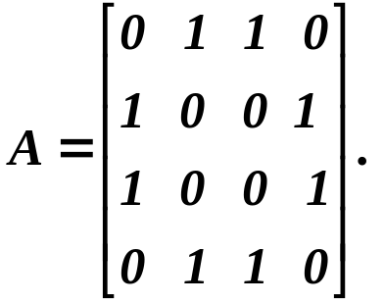
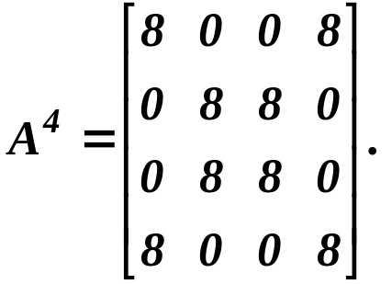
Connectivity (9.4) (cont.)
a
b
d
c
G
  Solution: The adjacency matrix of G (ordering the vertices as a, b, c, d) is
  Hence, the number of paths of length 4 from a to d is the (1,4)th entry of A⁴. Since
  there are exactly 8 paths of length 4 from a to d. By inspection of the graph, we see that a, b, a, b, d; a, b, a, c, d; a, b, d, b, d; a, b, d, c, d; a, c, a, b, d; a, c, a, c, d; a, c, d, b, d; and a, c, d, c, d are the 8 paths from a to d.
Dr. Djamel Bouchaffra
CSE 504 Discrete Structures & Foundations of Computer Science, Ch. 8 (part 2): Graphs

